Slide 1


Data Science
January 2025

Slide 2
GAN-Driven Approaches to Transfer Learning in Tabular Data
Foundations and Potential Applications in Structured Finance

Slide 3
Agenda
Introduction
What Cardo AI Does
What is Securitisation?
Sketching the problem
Generative Adversarial Networks for Tabular Synthetic Data Generation and Transfer Learning
Generative Adversarial Networks (GANs)
Vanilla GANs
f-Divergence Duality
f-GANs
Kantorovich-Rubinstein Duality and Wasserstein GANs
Conditional GANs
Conditional Tabular GANs
Transfer Learning in GANs

Slide 4
What is Securitisation?
Loans
Tradable Securities
Sells Loans
Sells ABS
Borrowers
Originator
SPV
Investors
Cash
Cash
Cash
Servicer
Cash
Principal + Interest Repayment

Slide 5
Asset Pool Cash Flow
Pre-amortization Period
Floating Interest Rate
Amortisation Plan
Borrower 1
Fixed Interest Rate
…
Known
Borrower 2
…
Delinquency Prob.
Default Prob.
Systemic Risk
Prepayment Prob.
Idiosyncratic Risk
Unknown
Loss Given Default
Recovery Rate
Borrower i
…

Slide 6
Asset Pool Cash Flow as a Markov Process
Issue Date
Installment i
Maturity Date
Borrower 1
Delinquency
Default
Alive
Prepayment

Slide 7

Asset Pool Cash Flow as a Markov Process
Borrower 1
Borrower i
Borrower n
Cash Flow Generated by Loan i+n at Time t
TIME = 2024/06/01

Slide 8
Cash Waterfall Structure
TIME = 2024/06/01
Formation expenses/administrative fees
Note 1
Interest and Principal Senior Tranche
Note 2
Note 3
Tradable Securities
Interest and Principal Mezzanine Tranche
Note 1
Note 2
Note 3
Excess Spread Junior Tranche Note

Slide 9
Cash Waterfall Structure
TIME = 2024/06/01
Formation expenses/administrative fees
Note 1
Interest and Principal Senior Tranche
Note 2
Note 3
Interest and Principal Mezzanine Tranche
Note 1
Note 2
Note 3
Excess Spread Junior Tranche Note

Slide 10
What are the Different Asset Classes in Securitisation?
Mortgage-Backed Securities (MBS)
Residential Mortgage-Backed Securities (RMBS)
Commercial Mortgage-Backed Securities (CMBS)
Asset-Backed Securities (ABS)
Auto Loans
Credit Card Receivables
Student Loans
Equipment Leases
Consumer Loans
Small Medium Enterprises Loans
Collateralized Debt Obligations (CDOs)
Collateralized Loan Obligations (CLOs)
Collateralized Bond Obligations (CBOs)
Whole Business Securitization
Revenue from entire businesses or franchises
Future Flow Securitization
Securities backed by expected future receivables

Slide 11
Sketching the problem
In the context of loan default classification, we aim to leverage synthetic data generation for tabular transfer learning.
This approach aims to overcome several challenges. Unbalanced datasets are a significant issue, as default cases often constitute a minority, making model training difficult. Moreover, banks do not share proprietary datasets, seeking predictions without exposing sensitive loan information. Privacy is another key concern—borrower data must remain confidential and not directly used, adhering to privacy regulations. The lack of historical data for new asset classes further complicates model training. Additionally, datasets can be noisy, with past data containing inconsistencies and errors that affect model accuracy.
By implementing tabular synthetic data generation and transfer learning techniques, we seek to generate new balance datasets, protect privacy, address proprietary concerns, supplement data for new asset classes, and mitigate noise.

Slide 12

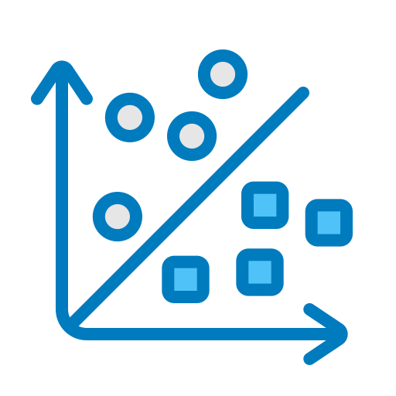
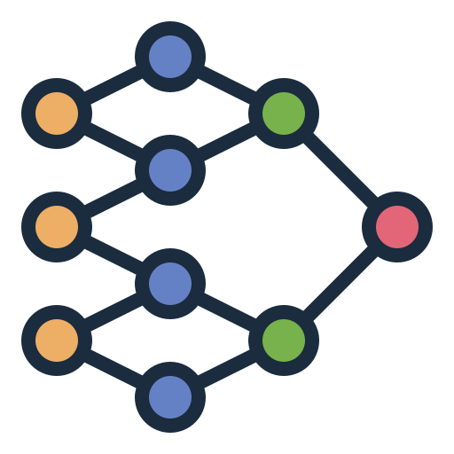
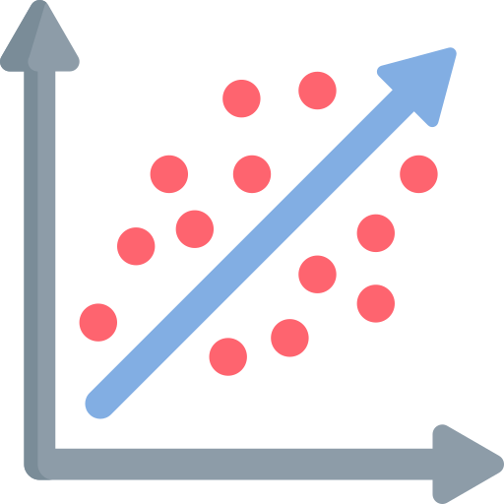
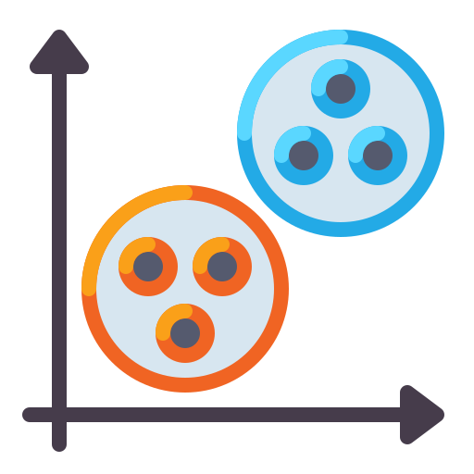

Sketching the problem
Public Data Sources for Multiple Asset Classes
Classification
RMBS
SME
CL
…
General Synthetic Data Model
Regression
Private Data Sources Single Asset Class
Clustering
Transfer Learning
…

Slide 13
Sketching the problem
Public Data Sources for Multiple Asset Classes
Classification
RMBS
SME
CL
…
General Synthetic Data Model
Regression
Private Data Sources Single Asset Class
Clustering
Transfer Learning
…

Slide 14
Sketching the problem
Public Data Sources for Multiple Asset Classes
Classification
RMBS
SME
CL
…
General Synthetic Data Model
Regression
Private Data Sources Single Asset Class
Clustering
Transfer Learning
…

Slide 15
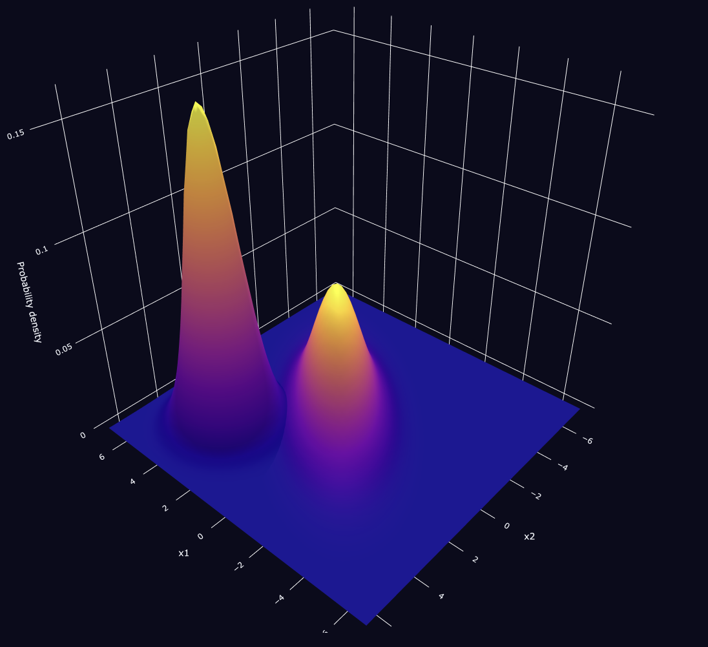
Deep Generative Models for Synthetic Data Generation
Z
X
Generative Adversarial Network
X
X
Z
Variational Autoencoder
Generative models operate by analyzing patterns and distributions within their training data to generate new data from user inputs. Through training, the model learns to identify the joint probability distributions of features in the dataset. It then uses this knowledge to produce new data samples that closely resemble the original training data.
X
X1
X2
Xi
Xn
Z
Diffusion Model

Slide 16
Deep Generative Models for Synthetic Data Generation
Z
X
Generative Adversarial Network
X
X
Z
Variational Autoencoder
Generative models operate by analyzing patterns and distributions within their training data to generate new data from user inputs. Through training, the model learns to identify the joint probability distributions of features in the dataset. It then uses this knowledge to produce new data samples that closely resemble the original training data.
X
X1
X2
Xi
Xn
Z
Diffusion Model

Slide 17

Generative Adversarial Network
Binary Cross-entropy
Z~𝛄
Fake Sample
Random Noise
Generator
G(z)
y
1
Real
log(D(x))
Discriminator
D(⋅) = ŷ
X~μ
0
Fake
log(1 − D(G(z)))
Training Data
Real Sample

Slide 18
Generative Adversarial Network
Mini-Batch = 10
Z~𝛄
Fake Sample
Random Noise
Generator
G(z)
E_{X~μ}[log(D(x))]
y
1
Real
Mini-Batch = 10
Discriminator
D(⋅) = ŷ
X~μ
0
Fake
Training Data
Real Sample
E_{z~𝛄} [log(1 − D(G(z)))]

Slide 19
Generative Adversarial Network
Mini-Batch = 10
min_{G} E_{z~𝛄} [log(1 − D(G(z)))]
Z~𝛄
Fake Sample
Random Noise
Generator
G(z)
y
1
Real
Mini-Batch = 10
Discriminator
D(⋅) = ŷ
X~μ
0
Fake
Training Data
Real Sample
Max_{D} E_{X~μ}[log(D(x))] + E_{z~𝛄} [log(1 − D(G(z)))]

Slide 20
Generative Adversarial Networks for Tabular Synthetic Data Generation and Transfer Learning
https://stefanopenazzi2.github.io/2025/01/05/F-Divergence-Duality.html
https://stefanopenazzi2.github.io/2025/01/05/F-GANs.html
https://stefanopenazzi2.github.io/2025/01/05/Kantorovich-Rubinstein-Duality.html
https://stefanopenazzi2.github.io/2025/01/21/C-GANs.html
https://stefanopenazzi2.github.io/2025/01/21/CT-GANs.html
https://stefanopenazzi2.github.io/2025/01/22/TransferLearning-GANs.html

Slide 21


www.cardoai.com
/cardoai
/cardoai_

Slide 22
All opinions expressed in this presentation are solely those of the author and do not necessarily reflect the views or positions of the Cardo AI Corporation.

